Slide 1
Blockchain & Digital Transformation
Gheis Mohammadi

Slide 2
Introduction
Background
Overview

Slide 3
Agenda
History of Blockchain
Centralized and Decentralized Networks
Basic Concept of Blockchain
Blockchain Platforms
Basic Concept of Crypto Currencies
Digital Transformation and Blockchain Applications
Markets & Jobs
Future

Slide 4
Historical Background of Blockchain
1998
2000
2008
2009
2014
2018-
1991-2008
Phase 1
Phase 1
Phase 2
Phase 2
Phase 2
Phase 2
Phase 3
A cryptographically secured chain of blocks is described for the first time by Stuart Haber and W.Scott Stornetta.
Developer(s) working under the pseudonym Satoshi
Nakamoto released a white paper establishing the model for a blockchain
Nakamoto implemented the first blockchain as the public
ledger for transactions made using bitcoin.
Blockchain technology is separated from the currency and its potential for other financial,
inter-organizational transactions are explored. Blockchain 2.0 is born
Computer scientist Nick Szabo works on ‘bit gold’, a decentralized digital currency.
Stefan Konst published his theory of cryptographic secured chains, plus ideas for
implementation
multi-applications of blockchain

Slide 5
Bitcoin Key Highlights
October 31, 2008: Bitcoin white paper published by the anonymous Satoshi Nakamoto.
January 3, 2009: 30,000 lines of C++ code spelled out the beginning of Bitcoin. The Genesis Block is mined.
January 12, 2009: The first Bitcoin transaction.
December 16, 2009: Version 0.2 is released.
In 2010 selling Pizza from a handful of merchants. Today, the amount of bitcoin used to purchase those pizzas is valued over $100 million
November 6, 2010: Market cap value exceeds $1 million USD.
Spring 2011, BitPay, The largest merchant services provider in Bitcoin history began
In 2011, the Silk Road, an online marketplace for illegal drugs, launched. It used bitcoin as its chief form of currency.
On April 23, 2011, Nakamoto sent Bitcoin Core developer Mike Hearn a brief email. “I've moved on to other things,". The future of Bitcoin, he wrote, was "in good hands."

Slide 6
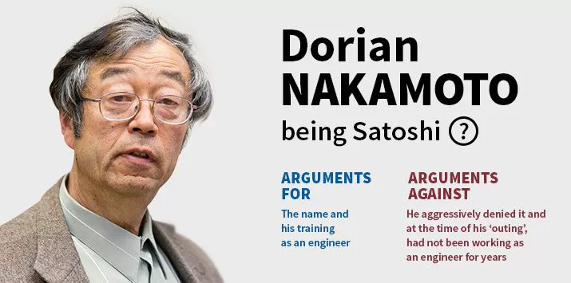
Satoshi Nakamoto

Slide 7

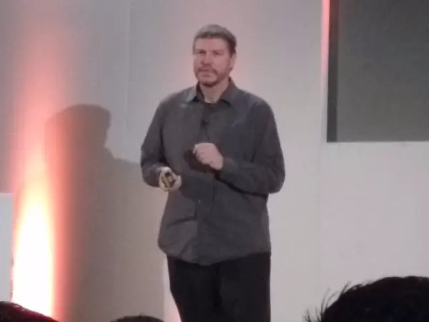
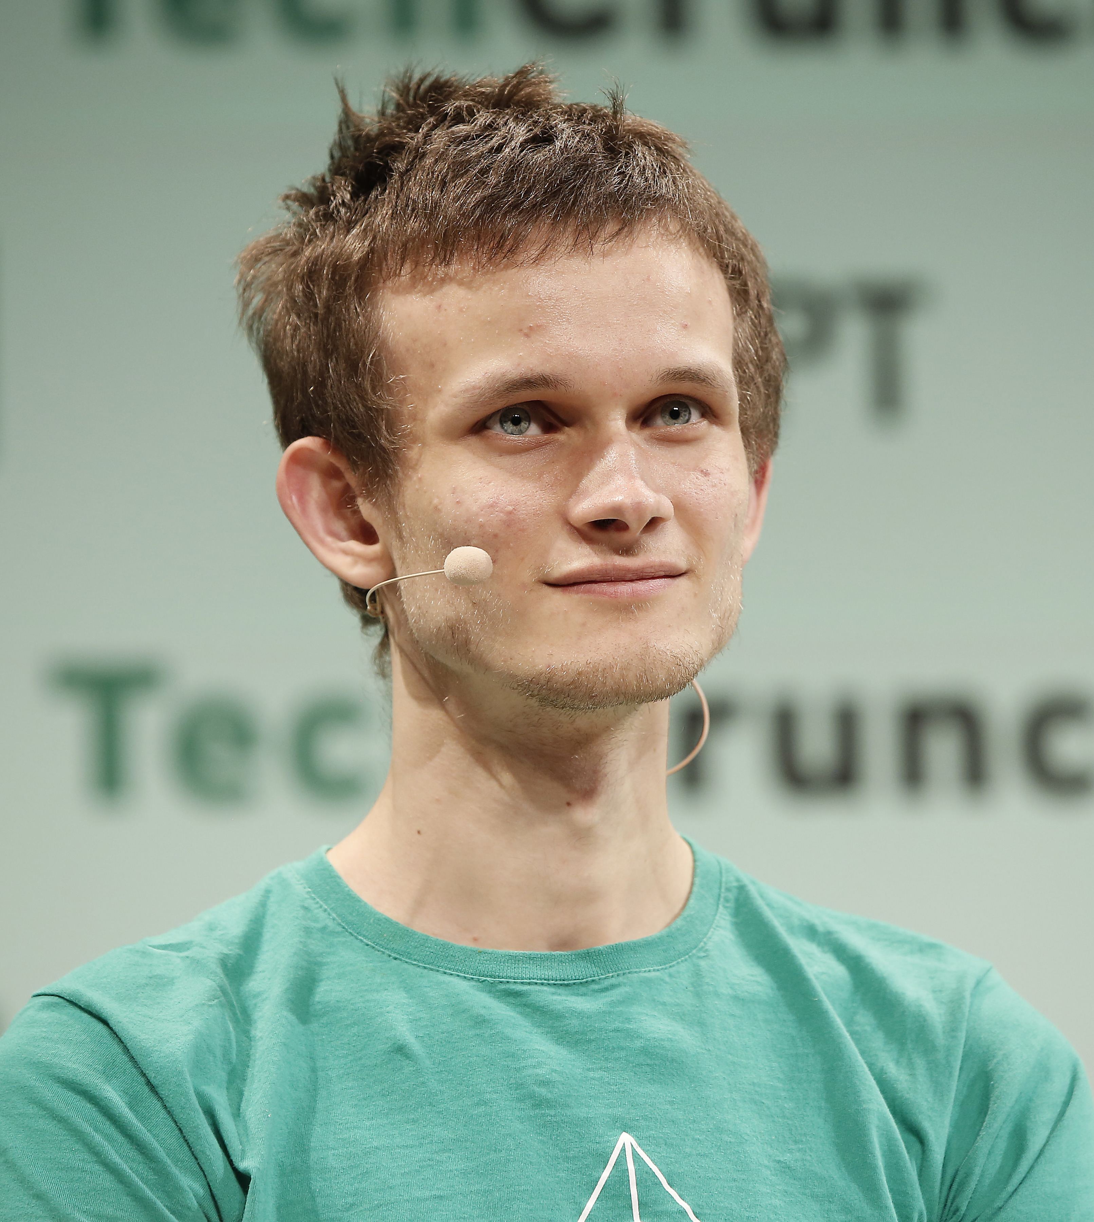
Satoshi Nakamoto
Craig Wright an Australian computer scientist and businessman
Nick Szabo
("bit gold" in the late '90s)
"Not Satoshi, but thank you."
Vitalik buterin

Slide 8
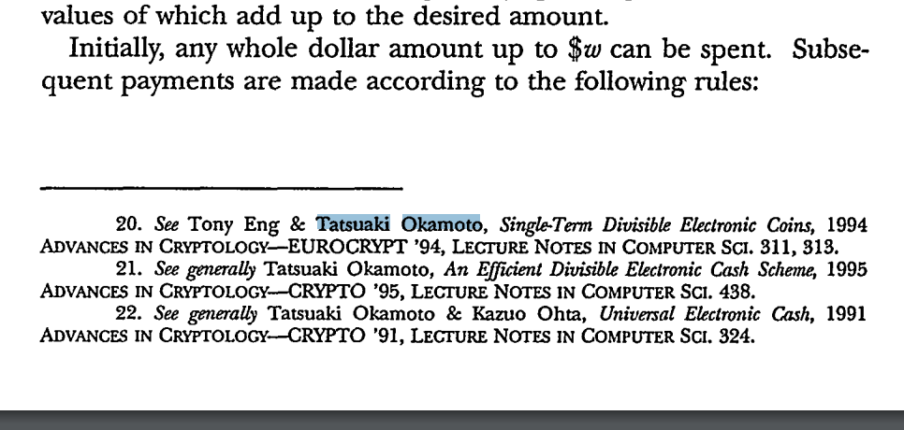
HOW TO MAKE A MINT: THE CRYPTOGRAPHY OF ANONYMOUS ELECTRONIC CASH
https://groups.csail.mit.edu/mac/classes/6.805/articles/money/nsamint/nsamint.htm
https://digitalcommons.wcl.american.edu/cgi/viewcontent.cgi?article=1389&context=aulr
National Security Agency Office of Information Security Research and Technology
Cryptology Division
18 June 1996

Slide 9
What is Blockchain Technology?
How it Works?

Slide 10
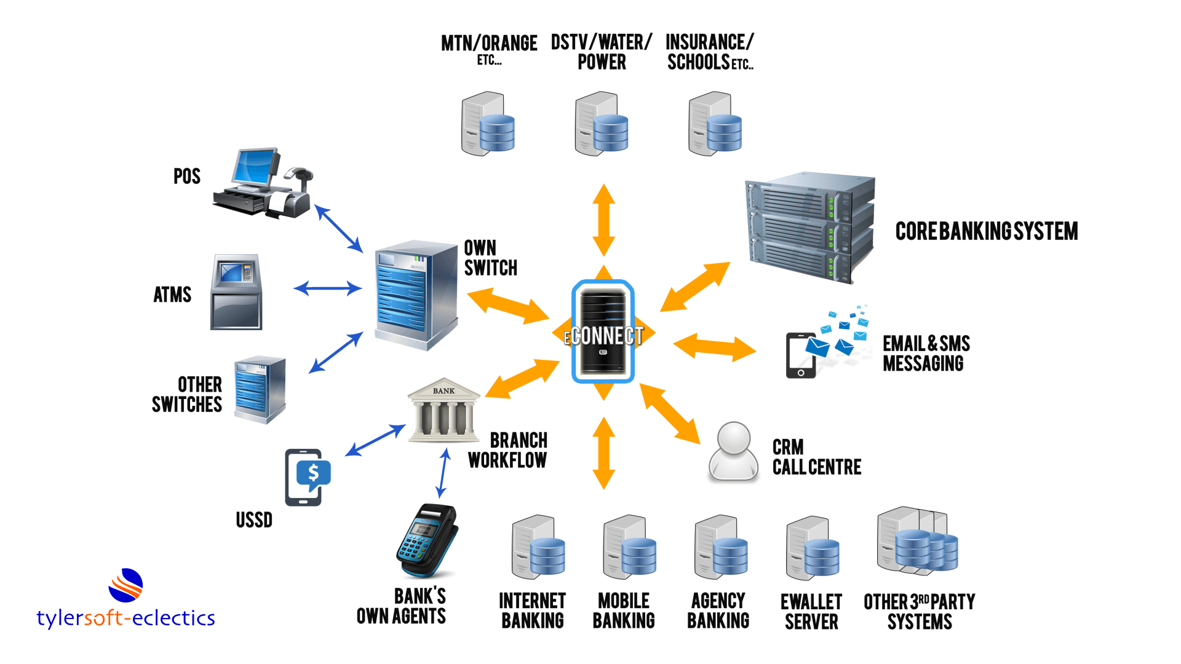
Traditional Banking

Slide 11
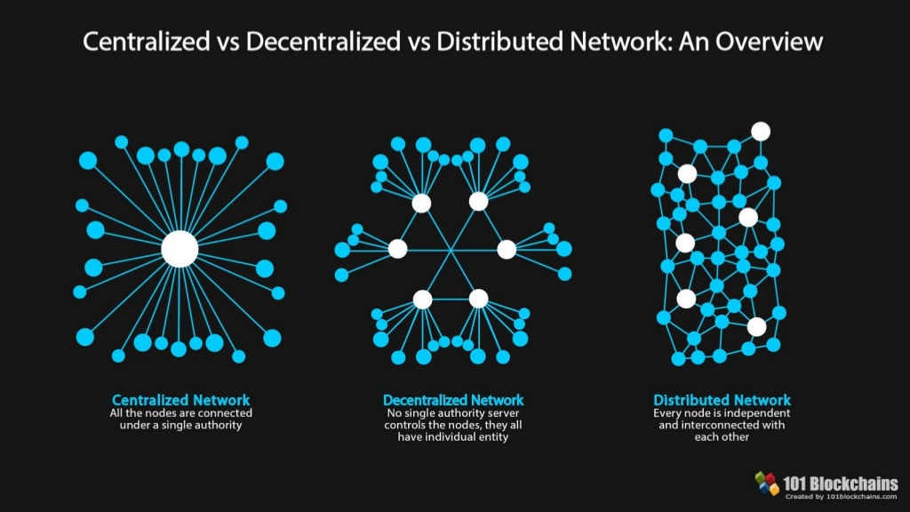

Slide 12
What is Blockchain?
Open, Distributed ledger that can record transactions between two parties efficiently and in a verifiable and permanent way
is a distributed digital ledger of transactions or a network of blocks; containing documented transactions (data and information) replicated and distributed through the network of computer systems that make up the blockchain.
Transactions (Irreversible/Pseudonymous/Fast and global/Secure/Permissionless)
Bitcoin: Is an open source censorship-resistance peer-to-peer immutable network trackable digital gold.

Slide 13
Blockchain characteristics and properties
Distributed / decentralized
Anonymous transparency with pseudonymity
third party is no longer needed in blockchain.
The identity of participants is unknown
Consensus and Peer-to-Peer Transmission
Programmable / Computational logic
A blockchain is programmable (‘Smart Contracts ’)
all the nodes must agree on the validity of the records and communicating with other nodes directly
Secure
All the records are encrypted
Time-stamped
Transaction timestamp is recorded in a block
Immutable
Any validated records are irreversible and cannot be changed

Slide 14
How Does Blockchain Work ?
The blocks in the chain are connected to each other in a peer-to-peer (P2P) connection where the first block of the chain is called the Genesis block.
How Blocks are Connected to Each Other ?
Each new block in the chain is linked to the previous block.
Each block has a copy of the other blocks' transactions that exist on the same network.
The blocks are connected like a chain by the hashes.

Slide 15
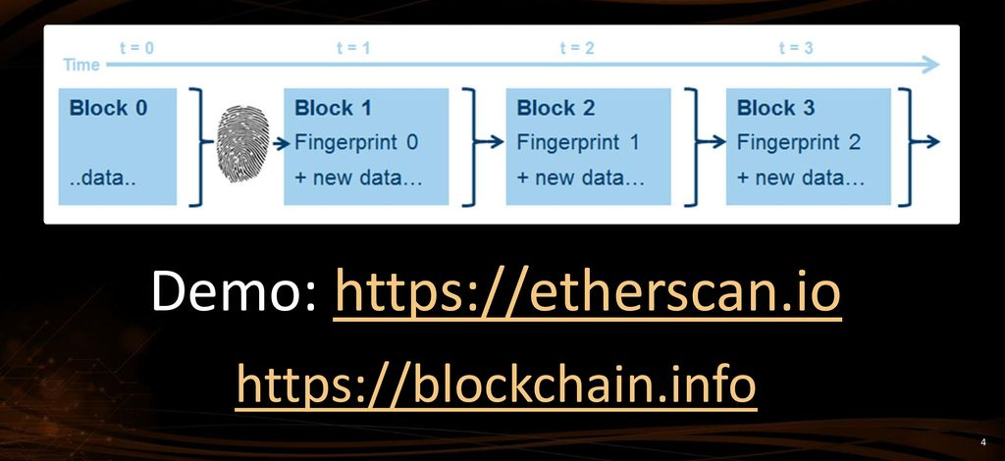
Blockchain == Chain of Blocks

Slide 16
Block’s content
Data.
Hash Code.
Consensus Algorithm.
Genesis block

Slide 17
How Blocks are Connected to Each Other
Blocks
Previous Hash
Transactions
Proof of Work
Previous Hash
Transactions
Proof of Work
Previous Hash
Transactions
Proof of Work
SHA 256
000000000000000000000000000000001011101110101001101011011010
SHA 256
000000000000000000000000000000001011101110101001101011011010
SHA 256
000000000000000000000000000000001011101110101001101011011010

Slide 18
Adding New Block to the Blockchain
The requested transaction is broadcast to a P2P network of computers ( nodes )
Block's validity
Transaction request
Block's validity checked by participants of the blockchain
The transaction is complete
New block is added to the chain permanently
New block of data is created

Slide 19
CRYPTOGRAPHY
Converting data into a format that is unreadable for an unauthorized user
In Blockchains:
Initiation and Broadcasting of Transaction
Digital Signatures
Private/Public Keys
Validation of Transaction
Proof of Work and certain alternatives
Chaining Blocks
Hash Function

Slide 20
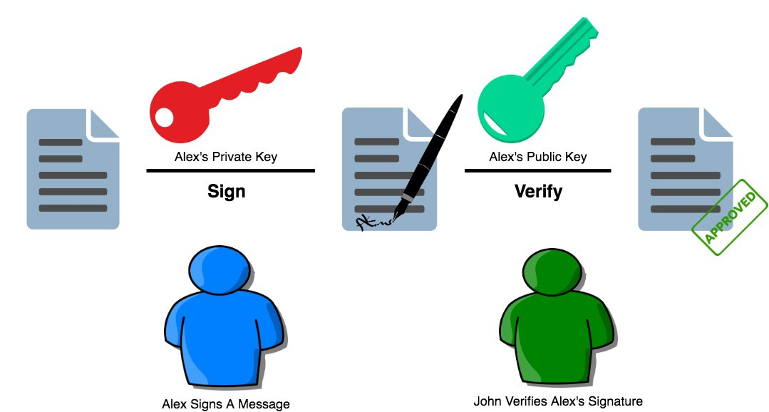
Digital Signature

Slide 21
Mining
Bitcoin miners are nodes in the Bitcoin network that possess specialized software technology called ASICs.
The Bitcoin miners constantly solve crypto graphically hard puzzles.
If successful, they get to add a block to the Bitcoin blockchain and get a reward, in return.
Currently, the bitcoin block reward is around 6.25 BTC.

Slide 22
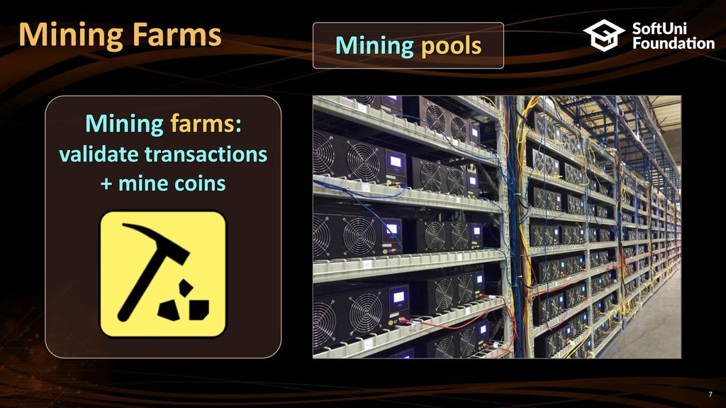

Slide 23
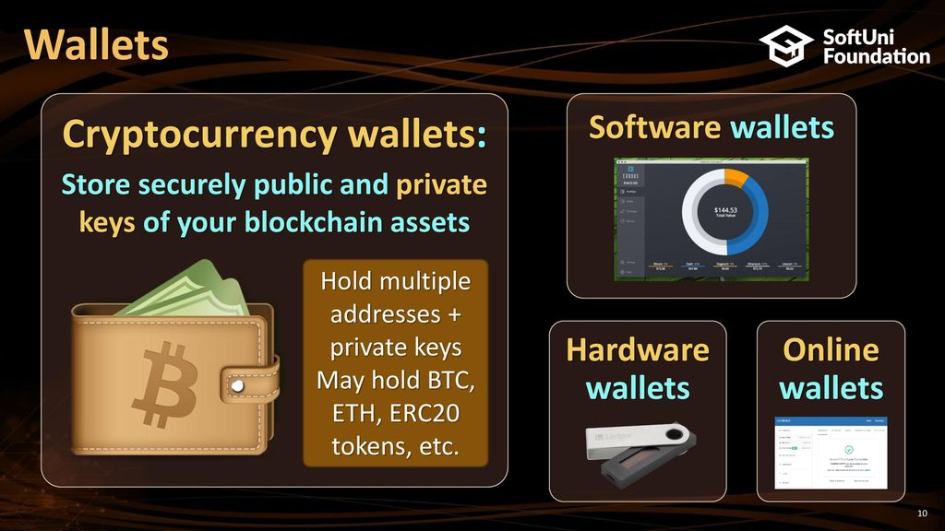

Slide 24
Characteristics
“White papers” often address key questions
Public Blockchains vs Private Blockchains
Permissioned vs Permissionless
One ledger or Segregated ledgers
Sharding (Watch debate: Alex Skidanov, CEO of NEAR Protocol and Anatoly Yakovenko, CEO of Solana)
Validation Methodology (depends on degree of trust between nodes.)
Consensus Mechanism (depends on degree of trust between nodes)
Interfaces/programming language
Supporting Smart Contracts
Reward and Staking

Slide 25
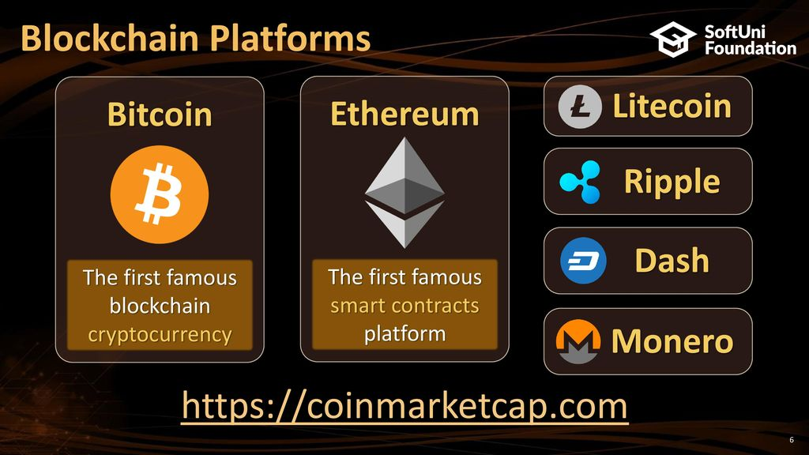

Slide 26
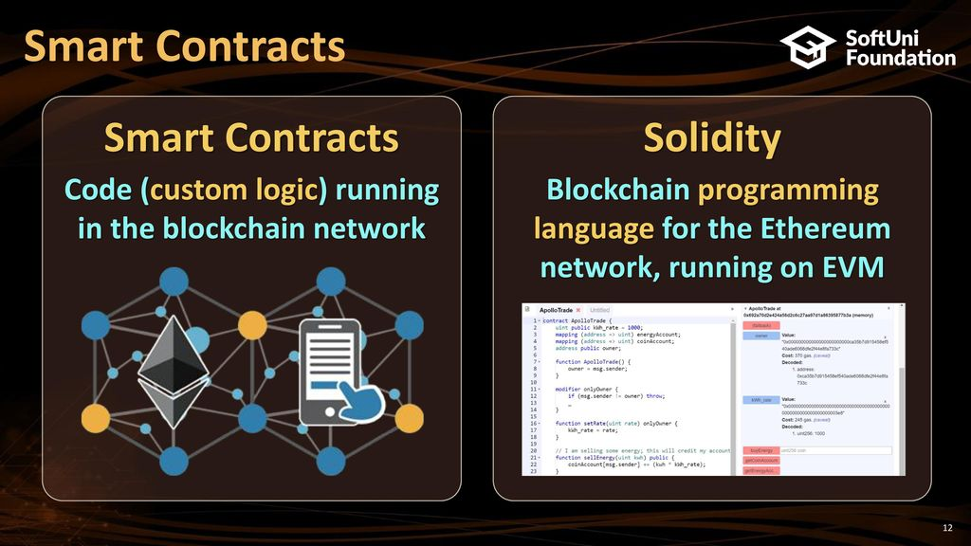

Slide 27
smart contract programming
Solidity
Ethereum, Tendermint, Binance Smart Chain, Ethereum Classic, Tron, Avalanche, CounterParty, and Hedera.
Rust
Solana, Polkadot, Near
Javascript
Hyperledger Fabric
Vyper
Similar to Python
Yul
Most Ethereum-based projects most likely already use Yul
Move
Aptos

Slide 28
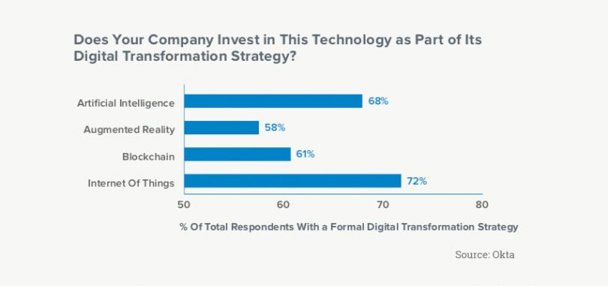
Digital Transformation

Slide 29
Digital Transformation & Blockchain
Blockchain is part of digital transformation strategy for over 61% of enterprises
Over 60% of the global 2000 will use blockchain services as a foundation for digital trust at scale
Nearly 6 in 10 large corporations are either actively considering, or are in the process of, deploying blockchain technology
Blockchain have many potential applications rather than financial services industry
Zero Trust

Slide 30
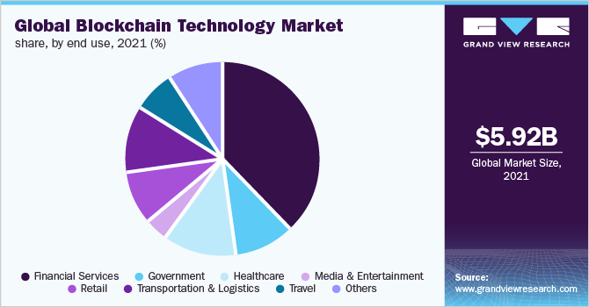
Digital Transformation

Slide 31
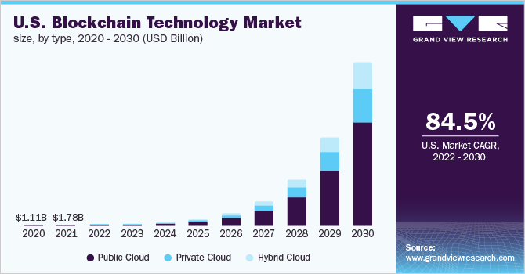
Digital Transformation

Slide 32
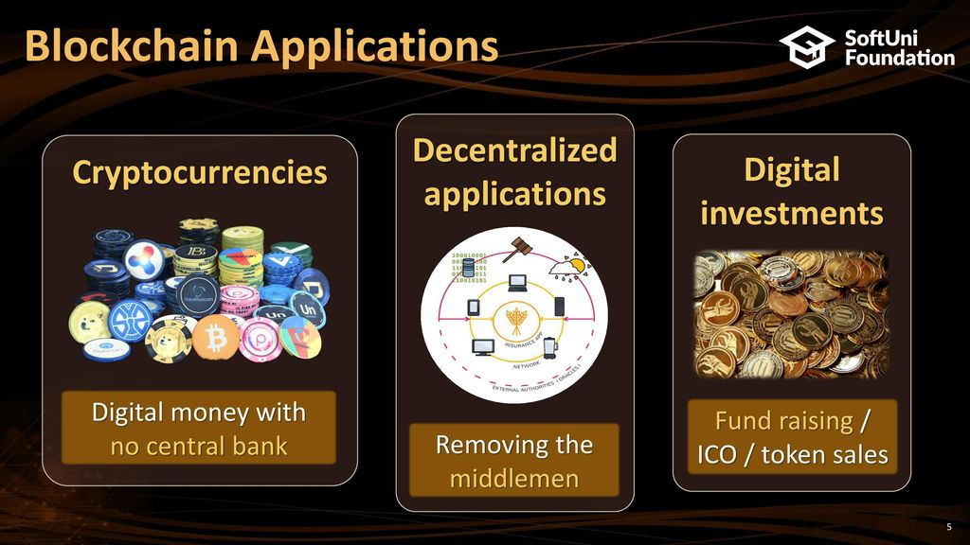
Applications

Slide 33
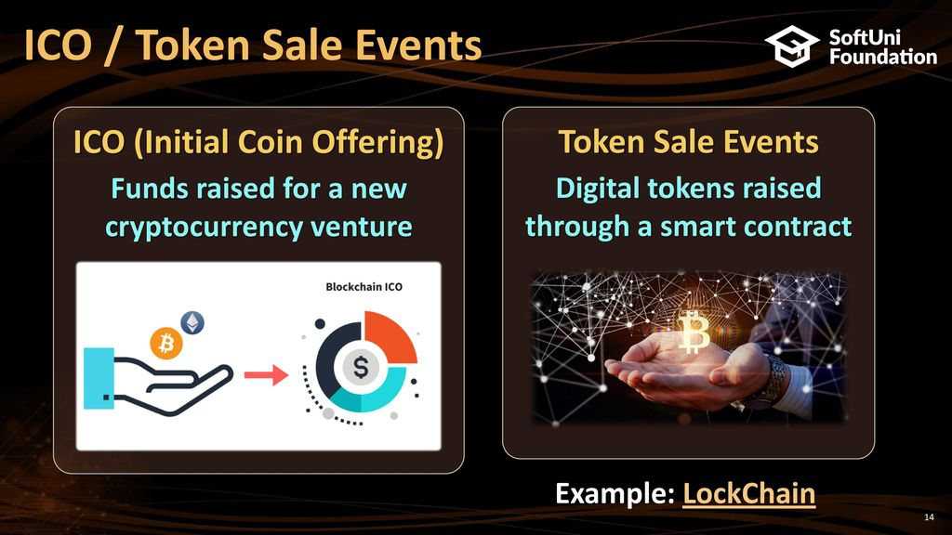

Slide 34
Top Real World Problems That Blockchain Solves
9
The problems that people in the world are facing and how blockchain helps in solving them..
Patient Data in HealthCare Organizations
5
Supply Chain Management
7
2
3
Traditional Contracts and Agreements
Cross-Border Payments
Data Security
10
1
6
Government Systems and Public Sectors
8
Crowdfunding
Identity Theft
4
Sports and eSports
Real estate

Slide 35
High Demand Markets
Supply Chains
Education
Healthcare
Insurance
IOT
Investing
Digital Assets & Bonds
Digital Banking & Payments
Game Industry
Data Management

Slide 36

Managing and Protecting Patient Data in HealthCare Organizations

Slide 37
Patient Data in HealthCare
Patient data include information relating to their past and current health or illness, their treatment history, lifestyle choices and genetic data
Key Problem: The lack of secure links that can connect all independent health systems together to establish reachable network by all Healthcare institutions.
Between 2009 and 2017: 176 million health records were compromised.

Slide 38
Patient Data in HealthCare Organizations after blockchain
Accessibility and transparency to all Healthcare institutions.
Security and reliability of patient data.
Also secrecy.

Slide 39
Blockchain companies for healthcare data management
 |  | Name | Location | Website
Blockchain and Healthcare Data Security |  | BURSTIQ | Denver, Colorado | https://www.burstiq.com/
 |  | MEDICALCHAIN | London, England | https://medicalchain.com/en/
 |  | GUARDTIME | Lausanne, Switzerland | https://guardtime.com/
Blockchain Medical Records |  | AVANEER HEALTH | Chicago, Illinois | https://avaneerhealth.com/
 |  | PROCREDEX | Tampa, Florida | https://procredex.com/
 |  | CORAL HEALTH | New York, New York | https://www.coralhealth.com/
 |  | PATIENTORY | Atlanta, Georgia | https://patientory.com/
Blockchain and Medical Supply Chain Management |  | CHRONICLED | San Francisco, California | https://chronicled.com/
 |  | EMBLEEMA | New York, New York | https://www.embleema.com/
 |  | BLOCKPHARMA | Paris, France | https://www.blockpharma.com/
 |  | TIERION | San Francisco, California | https://tierion.com/
 |  | SOLULAB | Los Angeles, California | https://www.solulab.com/
 |  | FARMATRUST | London, England | https://www.farmatrust.com/
Breakthroughs in Genomics |  | SHARECARE | Atlanta, Georgia | https://www.sharecare.com/
 |  | NEBULA GENOMICS | San Francisco, California | https://nebula.org/whole-genome-sequencing-dna-test/
 |  | ENCRYPGEN | New York, New York | https://encrypgen.com/

Slide 40
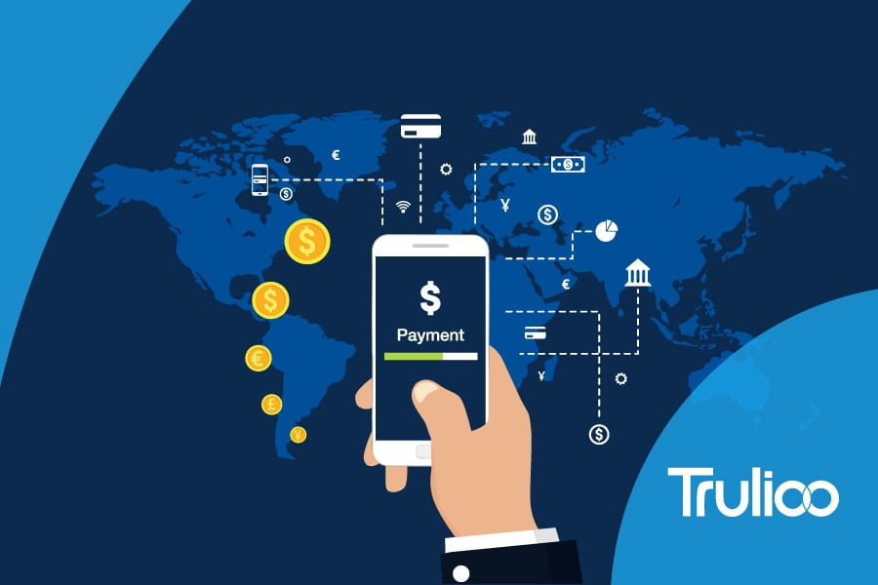
Cross-border payments

Slide 41
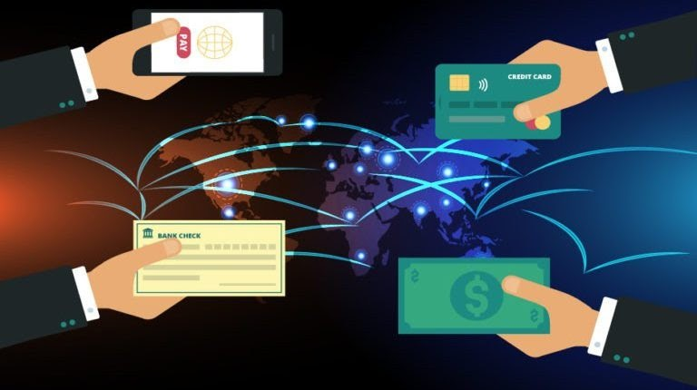
Cross Border Payments
Cross-border payments: are transactions where the payee and the transaction recipient are both located in different countries
Traditional Cross Border Payments:
Many steps to do
Needs a lot of time and effort
High cost
Requires third parties

Slide 42
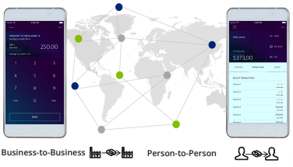
Cross-border Payments after Blockchain
Enabling Business-to-Business and Person-to-Person payments across borders on vendor blockchain-based payment rails.

Slide 43
Cross-border Payments after Blockchain
Enabling Business-to-Business and Person-to-Person payments across borders on vendor blockchain-based payment rails.
Low-Cost: 40–80% reduction in transaction costs.
Faster operation: takes around 4-6 seconds & eliminates any third party.
Promotes trust: Verifiable record of every transaction
Secure: Transactions can’t be altered or reversed, it guarantees more accountability & security.

Slide 44
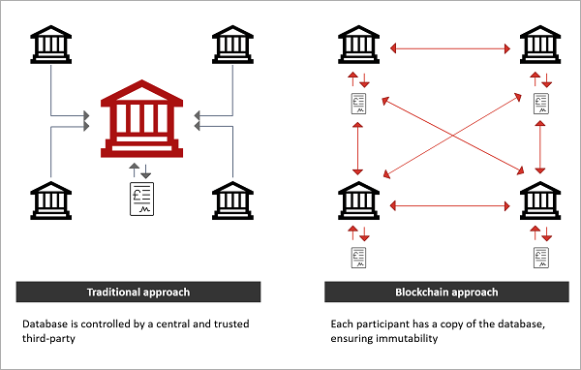
Traditional VS Blockchain Cross-border payments
SWIFT
Ripple

Slide 45
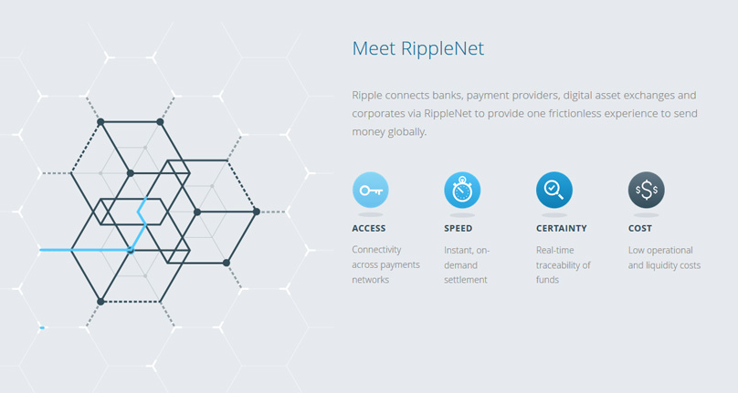
Ripple Net

Slide 46
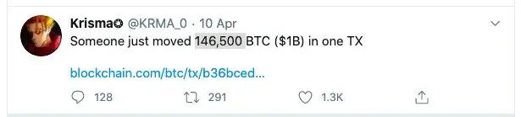
The Largest Bitcoin Transaction
https://www.blockchain.com/explorer/transactions/btc/b36bced99cc459506ad2b3af6990920b12f6dc84f9c7ed0dd2c3703f94a4b692
$1.1 billion (161,500 BTC)
April 10, 2020
Fee: 0.00010019 BTC ( $3.74 )

Slide 47


Slide 48

Data Security
the science and study of methods of data protection for preventing unauthorized access of data in computer and communication systems
Before Blockchain:
Centralized storage
Vulnerable to security breaches
Construct multiple barriers by requiring
several factors of authentication to
accessing data.
Several factors may cause centralized
databases to fail.
Need of a third party

Slide 49
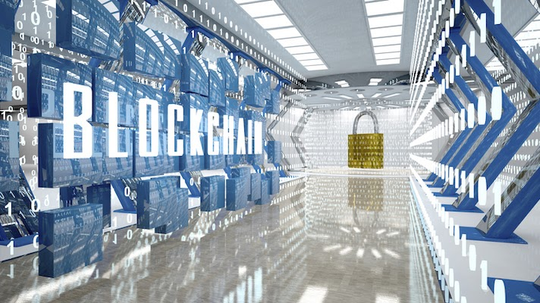
Data Security after blockchain
Increase security
Increase speed of cloud storage.
The data cannot be tampered with or stolen.
There is no need for a central entity or place to store data.
There is no need for a third party.

Slide 50
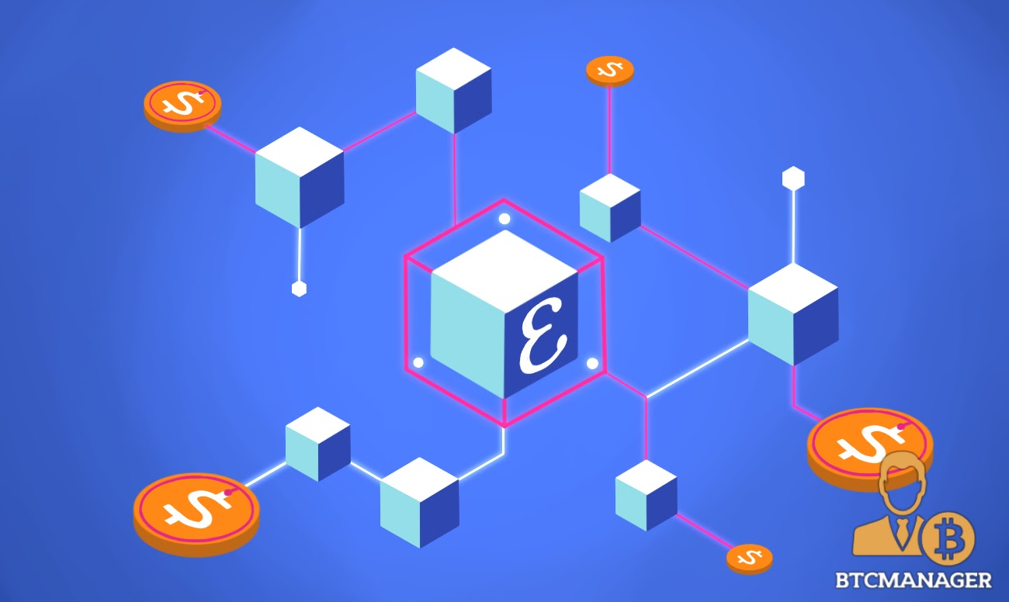
Enigma
http://livinglab.mit.edu/wp-content/uploads/2016/01/enigma_full.pdf
A decentralized computation platform with guaranteed privacy, and an evolution upon the blockchain technology.
goal is to enable developers to build a ‘privacy by design’, end-to-end decentralized application without a trusted third party

Slide 51

Real Estate

Slide 52
Real Estate
Real Estate are the assets owned by a company, group of people or an ordinary person, such as buildings, and lands which are physical, tangible, real and can be owned.
Before Blockchain:
Needs face to face engagement.
Needs prove the legal property.
Papers need to be signed by the government organizations.
Real estate fraud.
Real estate sector is vulnerable.

Slide 53
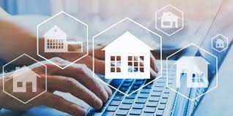
Real Estate Sector Development after Blockchain
- it enables the owners to digitize their assets and store them inside the blockchain cryptography.
- offers the speed and security.
- there is no third party control and validates the transaction.
- offers the transparency.
- Automation of the entire home-buying/selling process.

Slide 54
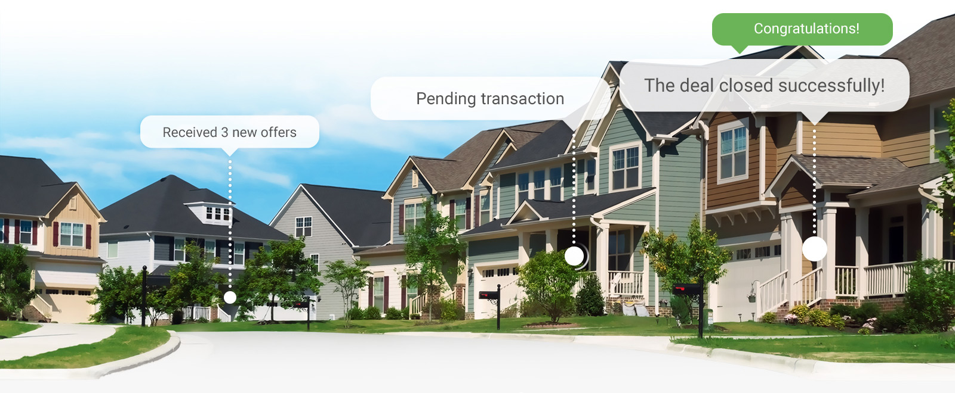
Propy Company
one of the first businesses to use smart contracts in the purchase and sale of real estate. A $60,000 apartment in Ukraine was the first transaction made using their system.

Slide 55
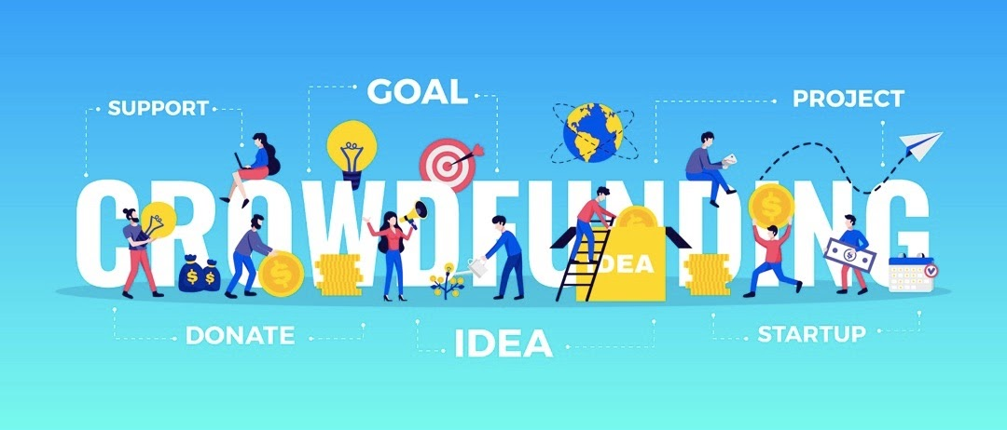

Slide 56
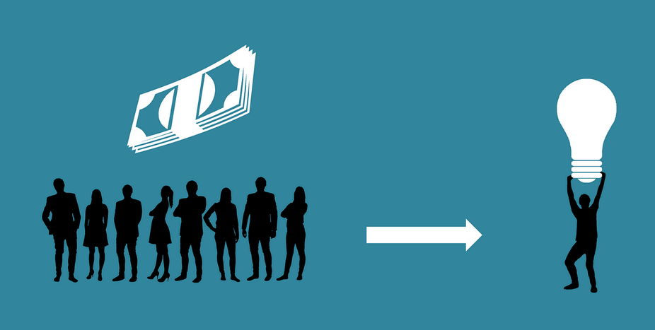
Crowdfunding
Collecting small amounts of donations from a large group of people to support a new business idea.

Slide 57
Traditional Crowdfunding
Security risks
Illegal Transactions
Fraud and abuse

Slide 58
An example of a crowdfunding scam
Asenergy Case (2015)
By leveraging crowdfunding platforms such as Fundable and EquityNet.
Raised 5 million dollars from about 90 investors.
The money was supposed to be spent on oil and gas operations.
The founder used most of the funds for overseas trips, dining, dietary supplements and personal care products.
Before the SEC took action, 1.2 million dollars had been siphoned off.

Slide 59
Crowdfunding after blockchain
Business issues tokens that serve as the company's stock.
The tokens can be purchased with fiat currencies such as USD
These Tokens can be tracked across the network.
Reliable
Transparent
Trusted
Cost-efficient
With blockchain transactions are

Slide 60
Highest-funded crowdfunding projects
https://en.wikipedia.org/wiki/List_of_highest-funded_crowdfunding_projects

Slide 61

Ruja Ignatova
FBI's Most Wanted Scammer
42-year-old woman, german citizen dubbed the 'Cryptoqueen'
European law at Oxford University
Behind $4 Billion Fraud
2014: defrauded billions of dollars from investors all over the world through her new company OneCoin (Bitcoin Killer)
October 2017: boarded a plane in Sofia, Bulgaria, and vanished with the stolen money.

Slide 62
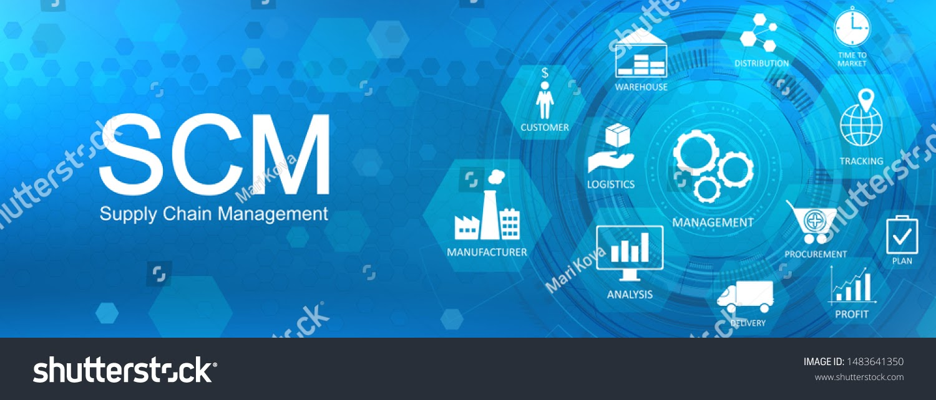

Slide 63
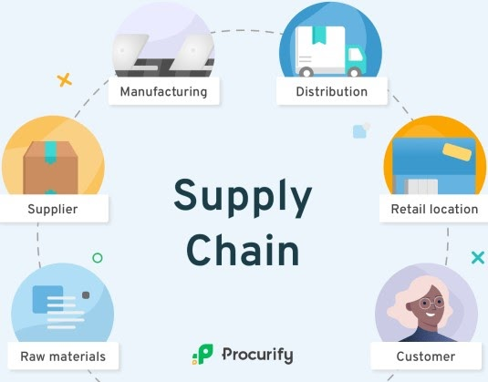
Supply Chain
Materials, information, and payments flow through the supply chain in both directions.
Before Blockchain:
Lack of transparency
Information disclosure
Data tampering
Single node attack
Security threats

Slide 64
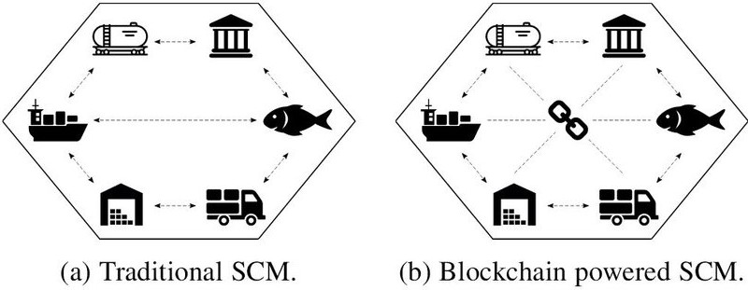
SCM after blockchain
supply chain companies can document production updates to a single shared ledger, which provides complete data visibility and a single source of truth. Because transactions are always time-stamped and up to date, companies can query a product's status and location at any point in time.
Secure traceability and control
Data immutability
Interoperability
Transparency

Slide 65
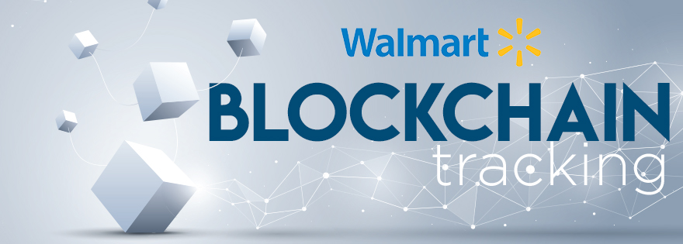
Walmart
Benefits after integrating with IBM for food safety in the supply chain:
- Reduction in fraud
- Improved supply chain efficiency
- Increased trust of the consumer
- Lower inventory and courier costs

Slide 66
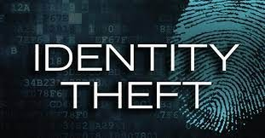

Slide 67
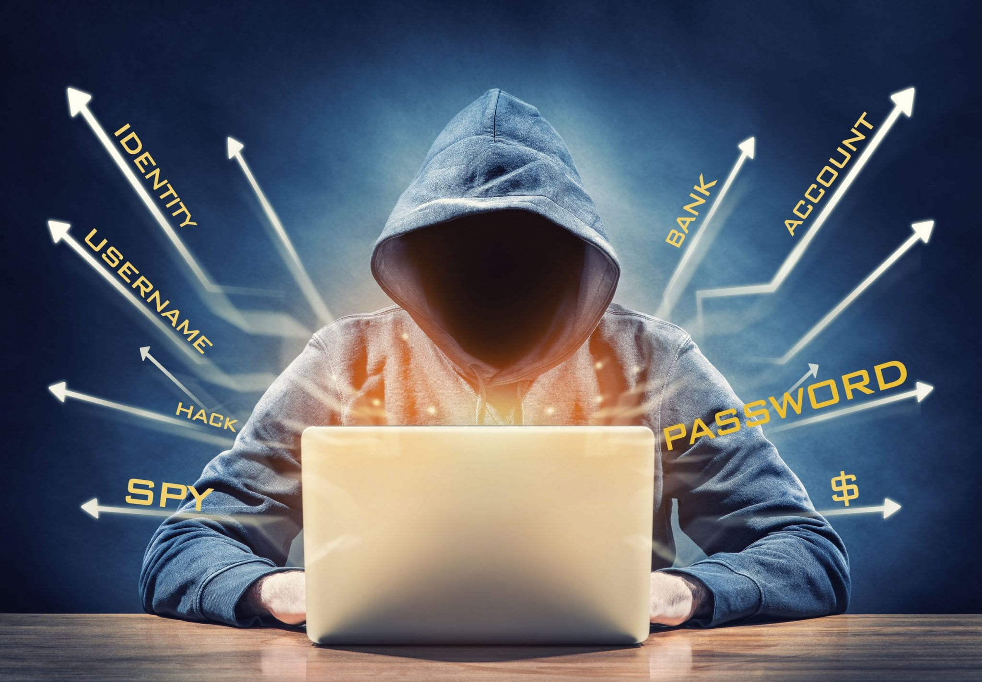
Identity Theft
Identity is a bunch of data entered telling who you are as a person such as:
Address
ID number
Passport number
Driver's license number …etc.
It’s all types of crime in which someone steals another person's personal or financial data in order to use them in fraud or deception.

Slide 68
How Identity theft can happen to a person?
SPAM
Internet
Receive applications for credit cards
In public places (shoulder surfing)
Hackers

Slide 69
What a criminal could do with it?
He will be able to commit various crimes such as:
False applications for loans and credit cards.
Fraudulent withdrawals from bank accounts.
Obtaining other goods or privileges.
!

Slide 70
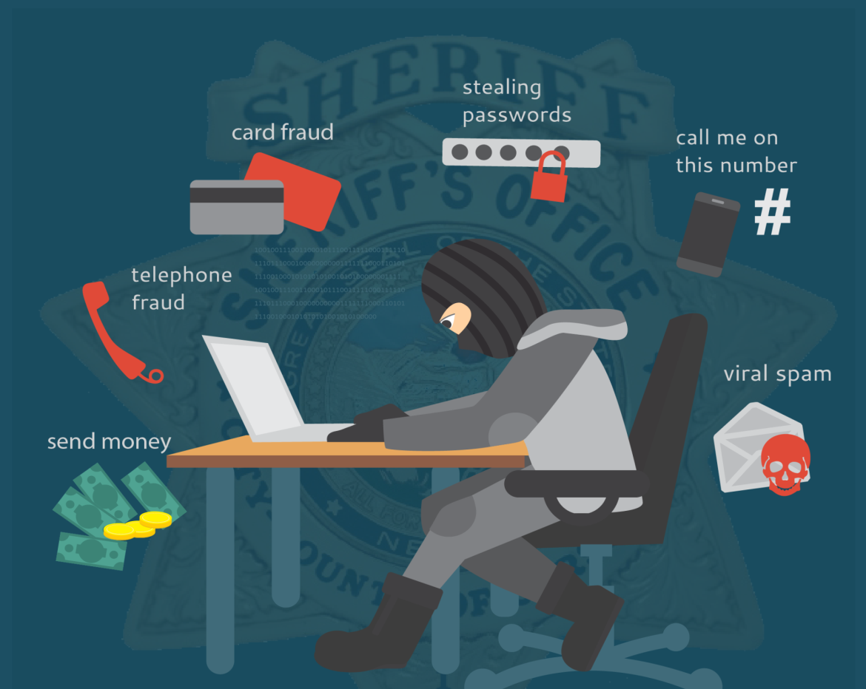
Issues with identity theft
Simple information can lead to identity theft.
Victims don’t recognize they are victims until they see the negative consequences.
An online survey by The Harries Showed that nearly 60 million people have been affected by identity theft in 2018, which is only in the USA.

Slide 71
Identity Theft after Blockchain
- Extremely difficult on hackers to manipulate data.
- Hackers needs to get access each device on the network.
- Records can only be deleted after consensus.
- Any modification will be reflected in the systems, which in its role will warn all participants.

Slide 72
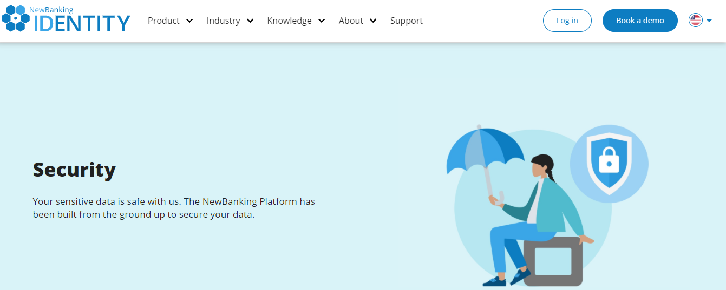
Example

Slide 73
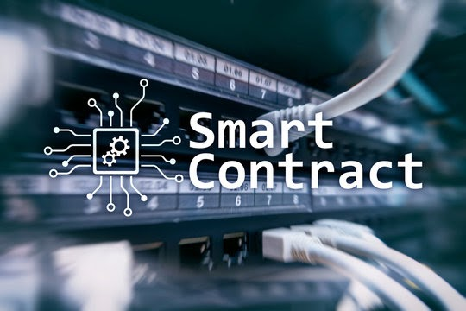

Slide 74
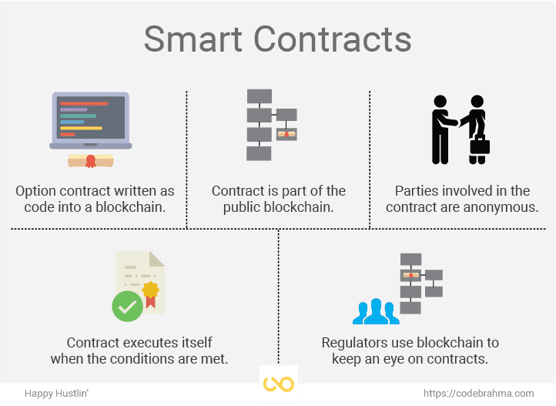
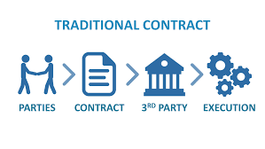
Smart Contracts
A smart contract is executable code that runs on the blockchain to facilitate, execute and enforce the terms of an agreement.
Traditional Contracts and Agreements:
- Multi-step process.
- Waste of time.
- Waste of money.
- Third-party involvement is
needed.

Slide 75
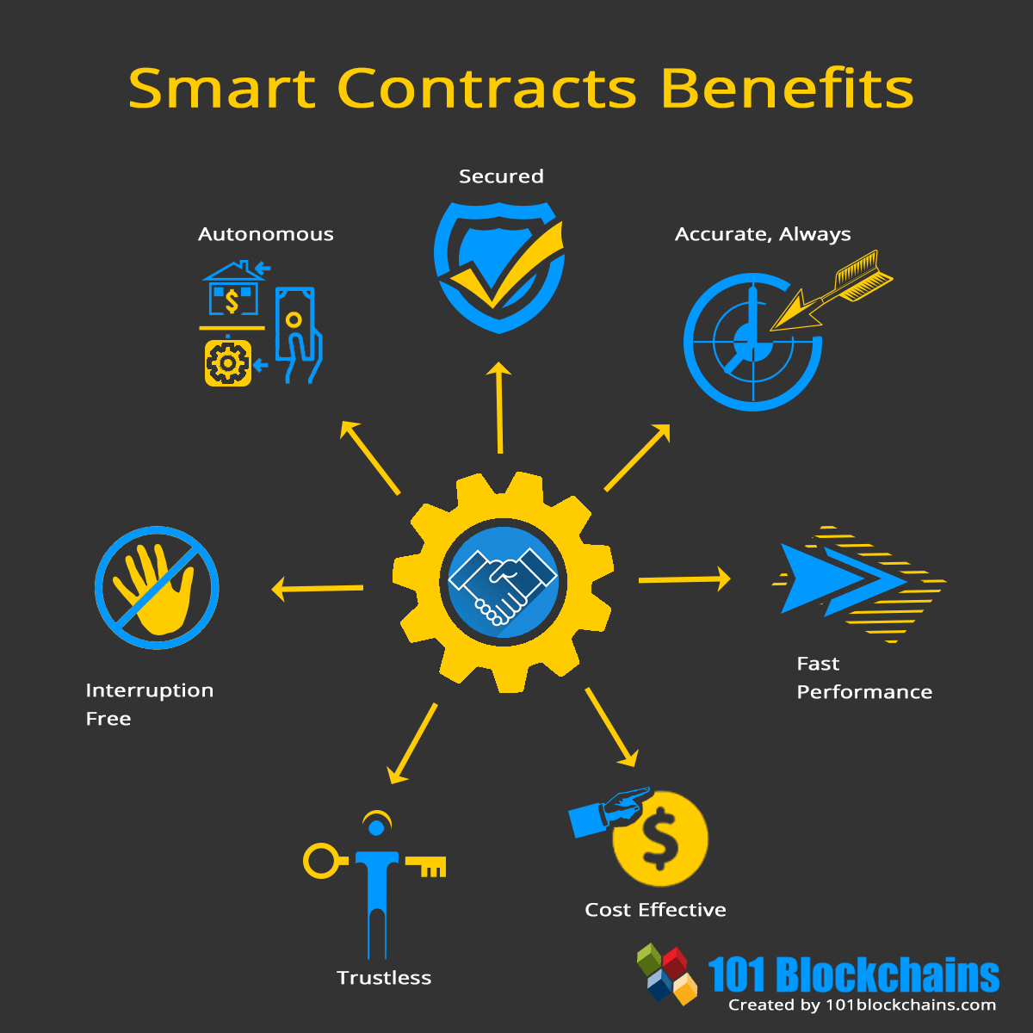
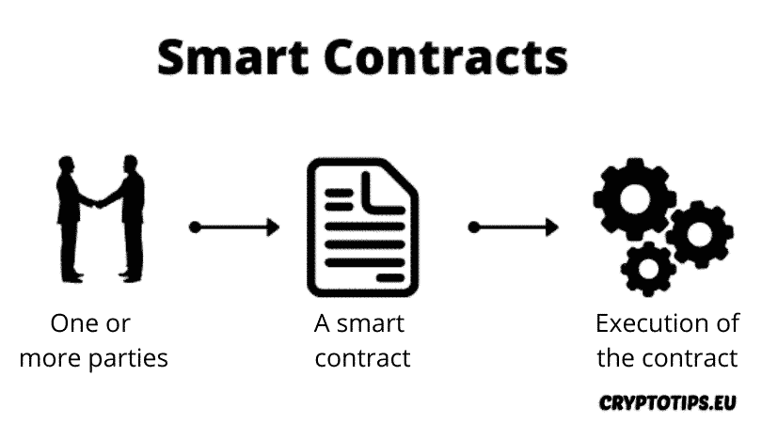
Contracts after Blockchain
When using blockchain technology, the problem of traditional contracts can be avoided.
Example: Smart contracts are used to encode rules to govern an organization

Slide 76

Sports and eSports

Slide 77
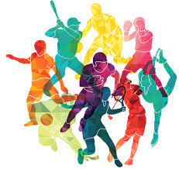
Sports and eSports
Sports and Esports : are part of the entertainment sector where each has its fans who are interested in catching up their news.
Sports and Esports:
Sports means the traditional championships
established in the real world such as football,
basketball and so on.
The eSport (Electronic Sports) means real time
competition, video games facilitated by
electronic devices (computers, smart phones,
PS4, and Xbox... etc.) used by cyberathletes to
play various numbers of games.

Slide 78
Issues with Traditional Sports and Esports
eSports
Sports
The absence of transparency.
Sponsorship management.
New investments obstacles.
Tickets Scalping.
The anonymity of the players identity.
Limitation of revenue stream models.
The existence of third-party(distributors).

Slide 79
Sports and Esports Development after Blockchain
A p2p connection
Decrease the time
Powering smart ticket systems
Using smart contracts and tokenization in crowdfunding
Detailed logs and cryptocurrency-based payment

Slide 80
Sports and Esports Development after Blockchain cont.
Preventing the manipulation and delaying the payments.
Developing new stream revenue models.
Reducing the costs.
There is no need for a third-party who controls the network.
High transparency.

Slide 81
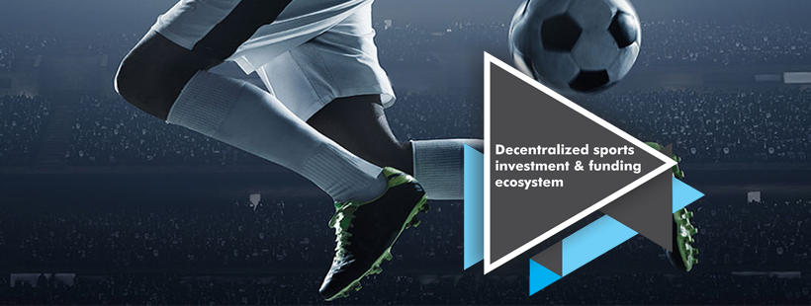
Sporty.co
Sporty.co is one of the firms who deployed blockchain technology in the sport industry. It published white paper in order to explain the big transformation towards using blockchain crowdfunding platform that
helps athletes, teams, and other sports organizations raise the money they need to succeed.

Slide 82
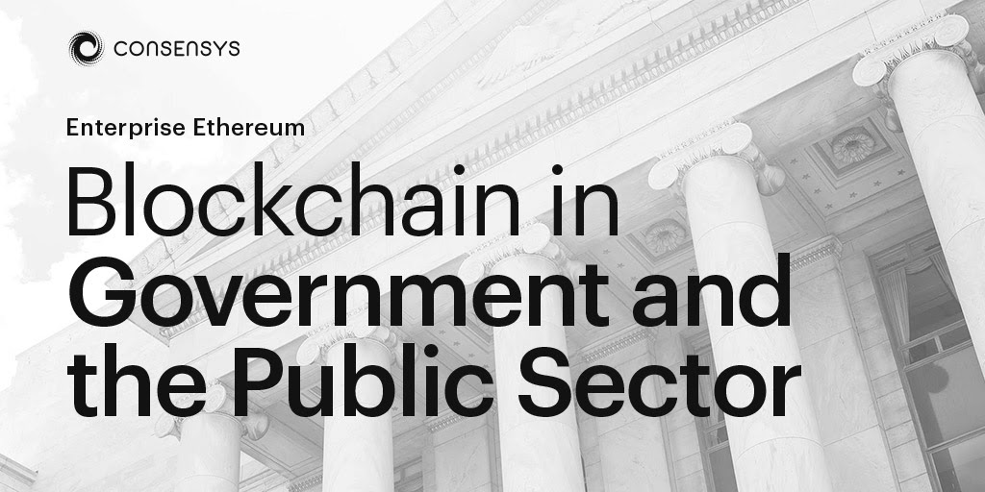

Slide 83

Government Systems and Public Sectors
Public Sectors: The grouping of units owned or controlled by public units is referred to as the public sector, Managed and funded mainly by the government, and all public companies.
All publicly controlled or publicly funded agencies/enterprises
Other entities that deliver public programs, goods, or services

Slide 84

Government Systems and Public Sectors
Government Systems: Systems used by the governments in order to accomplish its duties such as payments, land registration, voting for elections, healthcare, taxation, corporate registration, identity management, and legal entities management.
All publicly controlled or publicly funded agencies/enterprises
Other entities that deliver public programs, goods, or services

Slide 85
Governments and Public sectors before blockchain
Most of the governments and public sectors depend on old-fashioned methods and systems.
High Cost
Less Security
Slow
Opening the way to fraud and corruption.
Puts sensitive data at risk and leads to serious problems.

Slide 86
Governments Systems after blockchain
Structure is immutable (no fraud or data theft).
Safe exchange of resources and data.
Blockchain-based digital government
Saving time and money (automating a lot of activities).
Transparent government process (increase people's confidence in the system).

Slide 87
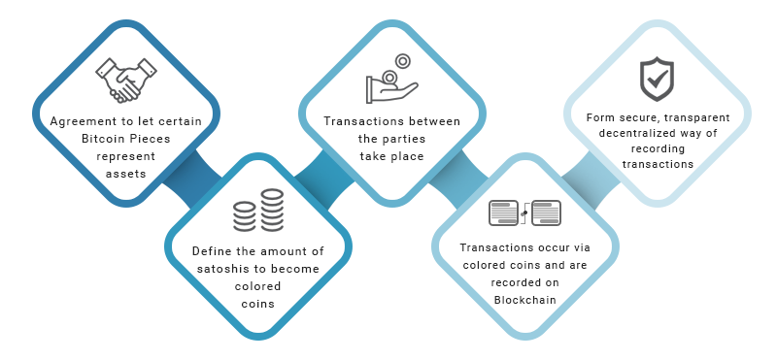
Public Sectors after blockchain
Time, Cost, Storage and Fraud
Security and Trust

Slide 88
Government and Blockchain
Benefits
Time
Cost
Risks of managing sensitive information
Providing an immutable and transparent audit trail for regulatory compliance, contract management, identity management and citizen services.

Slide 89
Examples
Government-led blockchain projects:
China → Blockchain-based asset custody(more than 100 transactions).
Dubai → Government documents management system.
Electronic voting systems based on blockchain:
Estonia → called i-Voting(National voting system).

Slide 90
Tax
Transparency, Efficiency, Data integrity, and security, can benefit the tax administration in multiple ways
decentralization can improve efficiency and the interaction between multiple actors
Blockchain could help address this problem as it allows information to be captured from many perspectives
Micro payment ( example: Bitcoin Lightning Network)

Slide 91
Islamic Economy
WAQF
Sukok
Haj

Slide 92
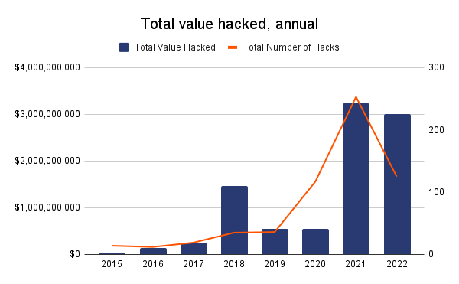

Security
John McAfee
47, 61, $5.42B, 250K

Slide 93
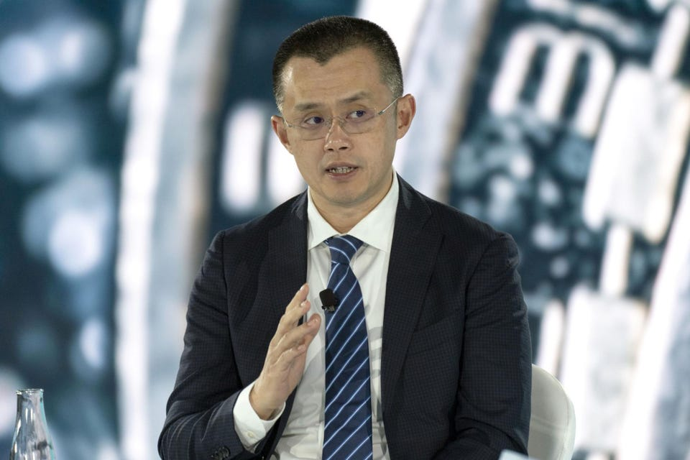
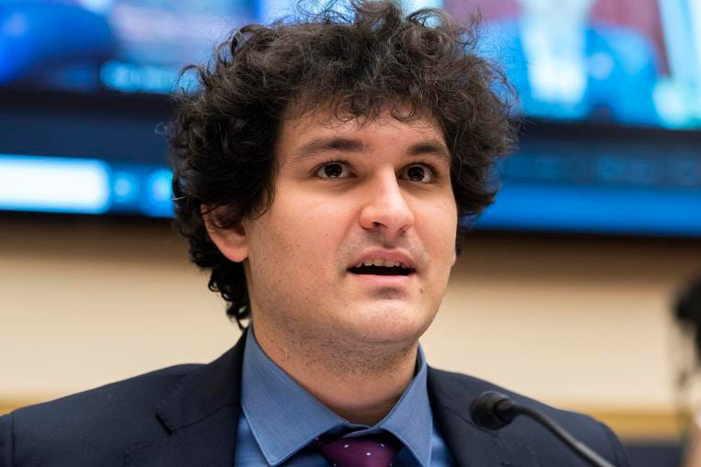
crypto’s billionaire club
Changpeng Zhao
(44 years old)
Net worth: $65 billion
Source of wealth: Binance
Citizenship: Canada
Sam Bankman-Fried (SBF)
30 years old
Net worth: $24 billion
Source of wealth: FTX
Citizenship: U.S

Slide 94
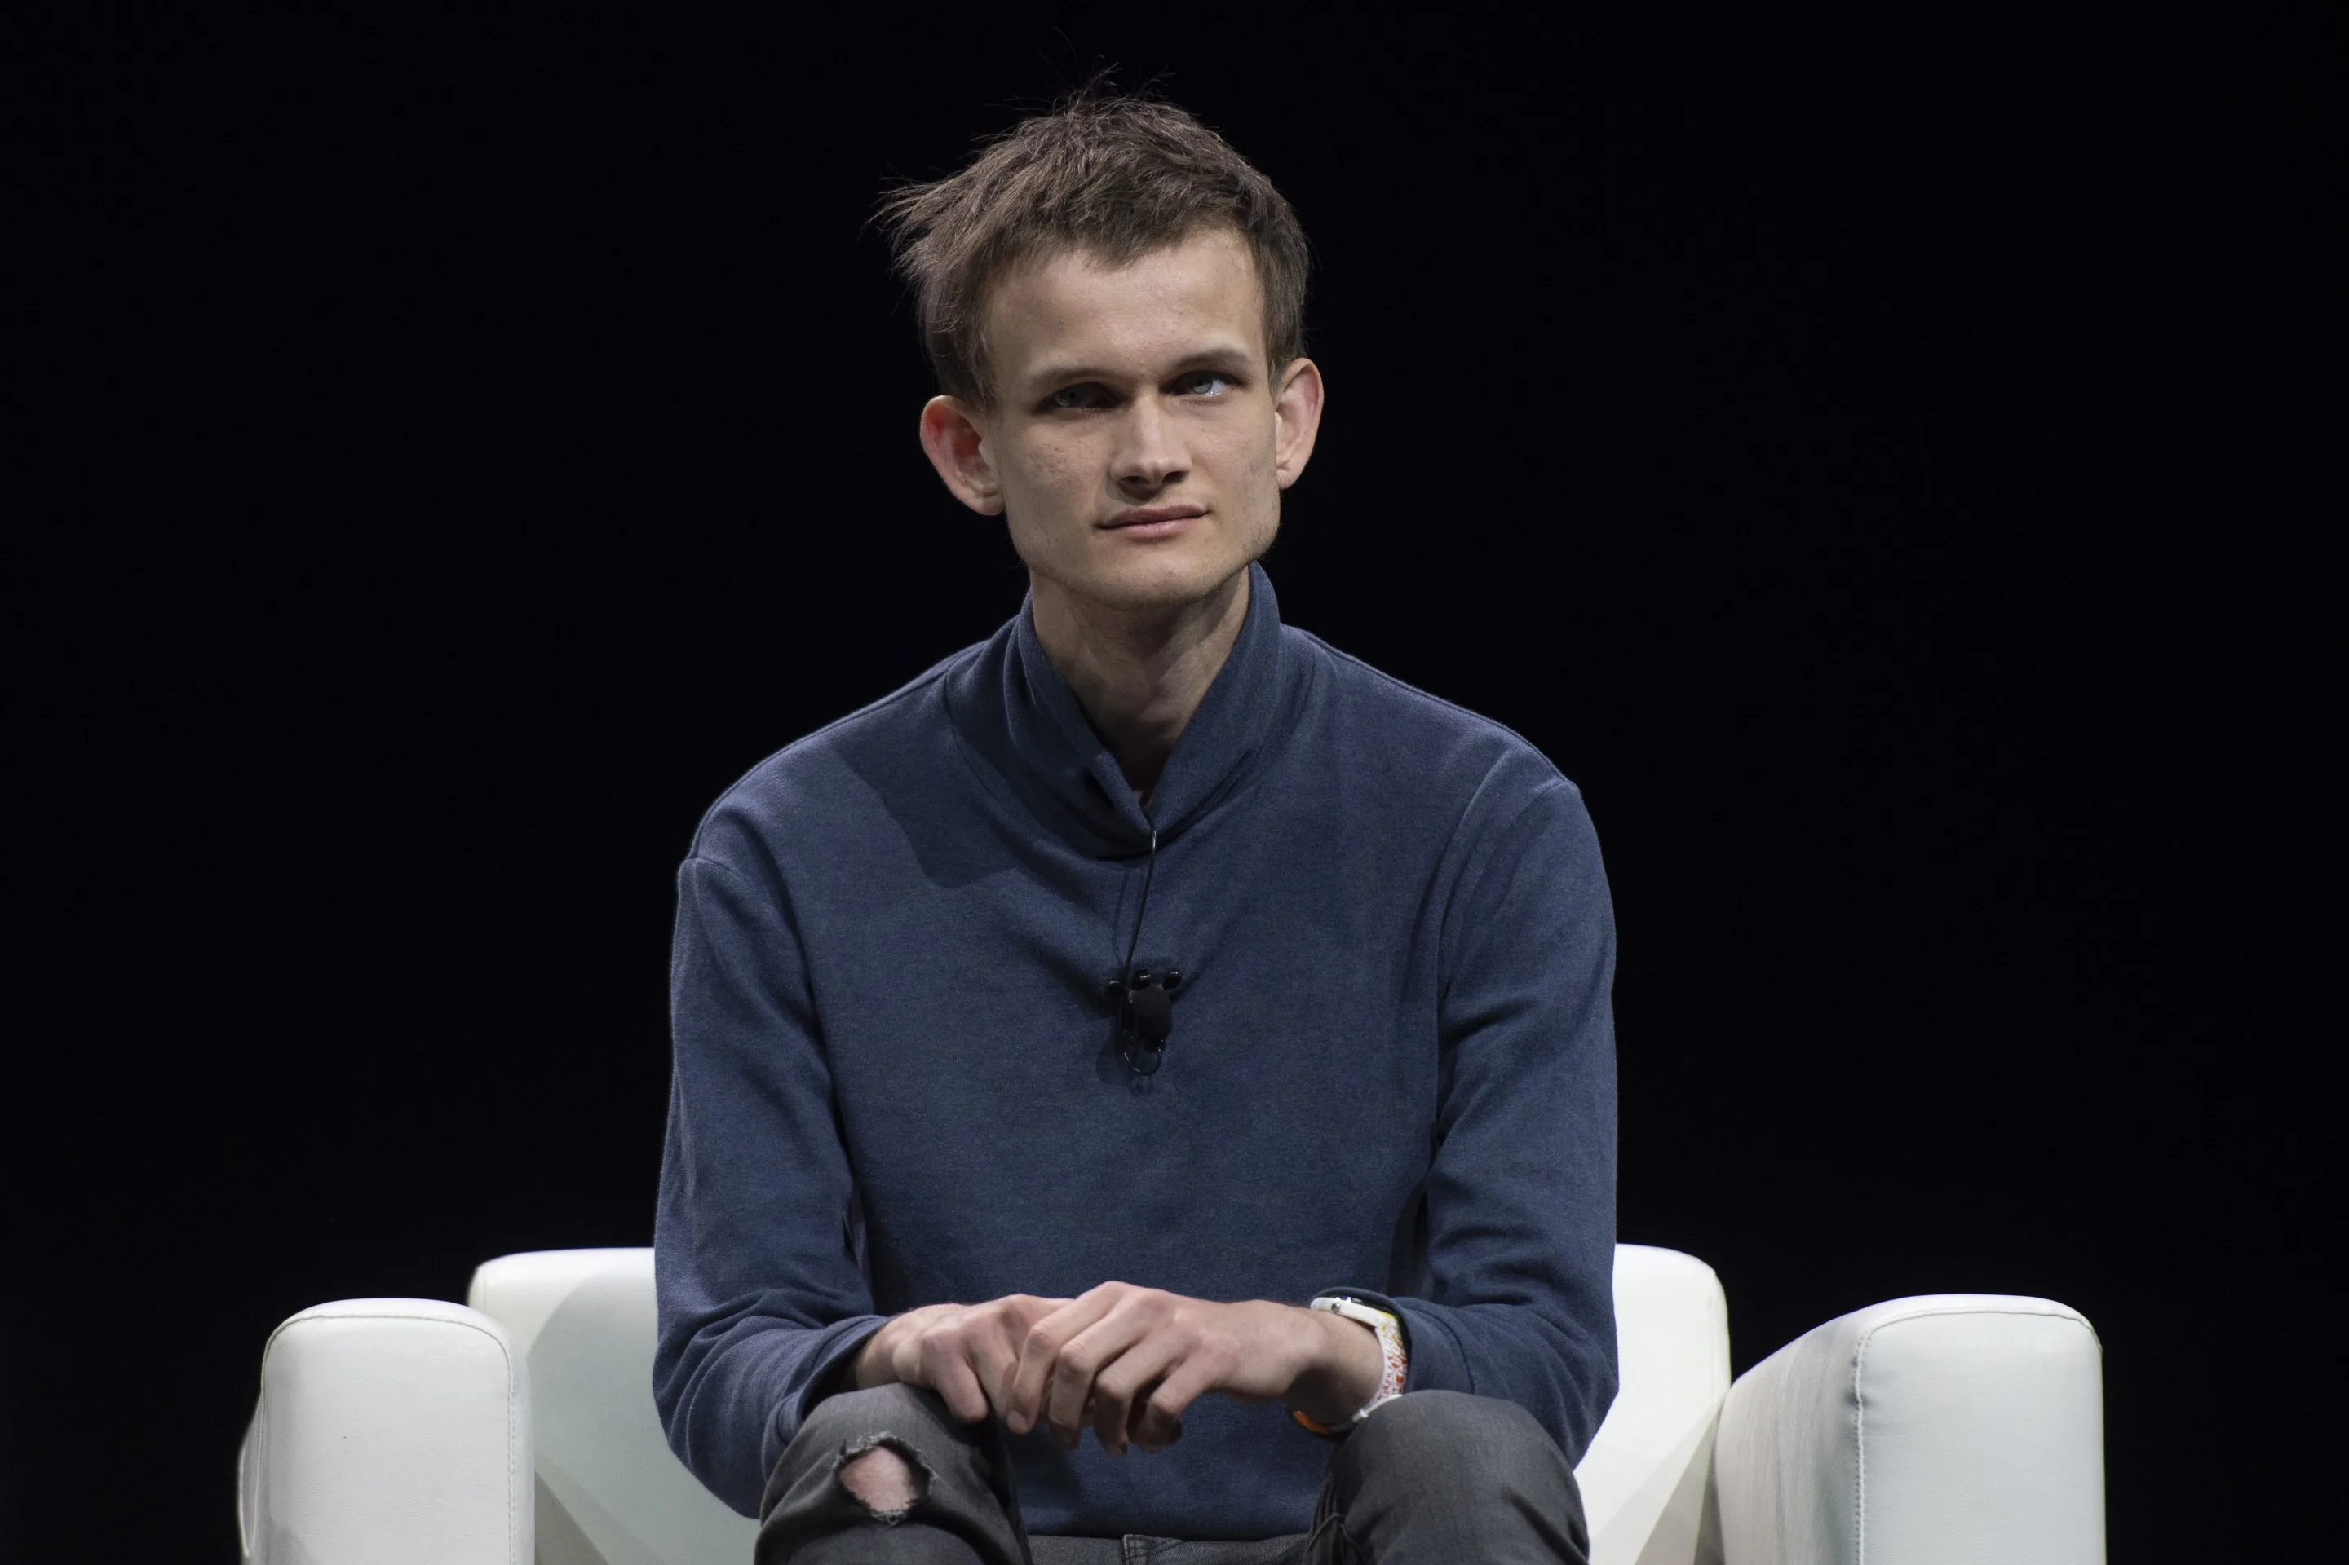

crypto’s billionaire club
Brian Armstrong
Net worth: $6.6 billion
Source of wealth: Coinbase
Citizenship: U.S
Vitalik Buterin
(28 years old)
290,000 Ethereum
Net worth: $1B

Slide 95

Negatives
Dark Web / Drugs / Gambling / Money Laundering
CryptoKitties
CryptoKitties is a game,
collectible!
Each cat is one-of-a-kind and 100% owned by you;
it cannot be replicated, taken away, or destroyed.
Market Cap: $20M in 2018

Slide 96


NFT (ERC721)
What is NFT ?
'Ghozali Everyday'

Slide 97



Weird NFT Sold
Jack Dorsey’s First Tweet
“just setting up my twttr”
Sina Estavi (Oracle CEO)
$2.9M
$48M/$2.9M → $280/$6,800
Beeple’s (Mike Winkelmann) Trump corpse
2020, $66,666.60 → $6.6M
CryptoPunk - $23.7 million
10,000 24x24 pixel art images
Bored Ape (10,000)
?
Justin Bieber $1.31M

Slide 98
Blockchain Jobs
Startup (?)
Developer & Engineer ($135,000 - $200,000+ per year)
Core developer
Tools
DApps & Smart Contracts
Adviser ($56,000 – $107,000 per year)
Audit ($120,000 and above)
Certik (net worth: $2B)
Solution & Designer (?)

Slide 99
High Salaries
Increased demand and short supply
Technology is on everyone’s radar
Established firms have embraced blockchain and announced initiatives
Microsoft Corp. (MSFT) has started a blockchain-as-a-service (BAAS) platform within Azure, its cloud division
IBM Corp. (IBM) has also launched a division dedicated to blockchain, basing it on an open-source fabric Hyperledger.
Social media behemoth Facebook Inc. (FB) has formed a group to explore blockchain’s uses in its business.
Hundreds of DeFi projects and Marketplaces
A shortage in skills supply has helped further inflate salaries for blockchain experts.
Several new initiatives are being launched to plug the gap in supply, from bounty programs to encourage developers to boot camps introducing the technology to developers.
Universities are also in on the game and have launched online courses to educate professionals.

Slide 100


Slide 101


Slide 102

Future of Blockchain
“The Future Will Be Decentralized. Who will control the next big thing online? Everyone and no one.”
- Tyler Cowen
FUTURE
“Blockchain technology has the potential to revolutionize industry, finance, and government—a must read for anyone interested in the future of money and humanity.”
- Perianne Boring
“We believe that blockchain technology will be transformative in the tech and IT sector in the coming years, similar to what the internet did for the world back in the 90s and early 2000s,”
- John Zanni

Slide 103

Future of Blockchain
Empower people in developing countries.
The use in voting systems.
CBDCs
That DeFi Will Continue to Increase(Decentralized finance).

Slide 104
Future of Blockchain
The number of transactions beyond conventional mechanisms and mediums would increase substantially.
Help in improving the safety of big Data.
Democratize ownership and sharing of big data.

Slide 105
Future of Blockchain
Blockchain is the future for the world and it could be the next generation of the Internet.
Blockchain has overcome the centralized system issues.
Blockchain technology has the ability to solve a lot of problems by its characteristics.
Benefits:
Unintentional deletion
Alteration of data
Time, Cost and Effort(for each transaction)

Slide 106
Recommendations
Keep on searching Blockchain development and applications in various fields.
Invest more in blockchain (research, apply it in order to develop).
Starting new majors/courses related to blockchain technology in universities.
Conducting more time and work to the application and incorporation of the Blockchain into the key industrial directions.

Slide 107
Looking ahead to 2024
a lack of understanding could very well lead to risk for governments and companies in the future.
move to the next generation of web development are going to need to get into cryptocurrency
adoption of crypto and stablecoins
Asia is a hot spot for crypto infrastructure, stablecoins and the CeFi/DeFi market.
100% to 150% growth in crypto adoption in Asia.
TRON, for example, is handling around 10 million transactions every day, with around 5 to 6 million active users
decentralized identity (dID)
soulbound items (SBT)
powerful items that cannot be transferred or sold to other players after a user picks it up
his technology will soon be implemented by countries around the world and create a more compliant and robust system
Blockchain Gaming Industry
Regulatory

Slide 108
References to learn Blockchain
Udemy (https://www.udemy.com/topic/blockchain)
MIT courses (https://ocw.mit.edu/courses/15-s12-blockchain-and-money-fall-2018/)
Github Index: https://gist.github.com/sin2akshay/65cdfe2f7fa1f84b4914f188d49d5323
Crypto Zombies (https://cryptozombies.io/)
Learn Blockchain, Solidity, and Full Stack Web3 Development with JavaScript — 32-Hour Course (https://youtu.be/gyMwXuJrbJQ)
Alchemy University:
1. JavaScript Fundamentals
2. Ethereum Developer Bootcamp
3. Road to Web3
SPEEDRUN ETHEREUM (https://speedrunethereum.com)
Buildspace (https://buildspace.so)
LearnWeb3 (https://learnweb3.io)
BANKLESS ACADEMY (https://app.banklessacademy.com)
Developer DAO Academy (https://school-of-code.vercel.app)
Ethereum Developer Resources (https://ethereum.org/en/developers)

Slide 109


Slide 110
Test 1
Bitcoin (Digital Gold) vs Gold

Slide 111
Test 2
Distributed Database vs Blockchain

Slide 112
Test 3
Blockchain Application

